Slide 1

FACE EMOTION DETECTION
Presented BY: Priyanshu
Section : A
University Roll NO : 2016929
Guided By: Mr. Ashwini Kumar

Slide 2
Introduction
What is Face Emotion Detection?
Face emotion detection, also known as facial expression recognition or facial emotion recognition, is a technology that analyzes facial expressions to emotions expressed by an individual.
Emotion recognition can be used to improve human-computer interaction by enabling systems to understand and respond to users' emotional states.
This technology helps to improve product quality by monitoring customer behavior.
It can assist in assessing patients' emotional states and monitoring mental health conditions.

Slide 3
Algorithm Used for Detection
The algorithm which I used for detection is CNN which is Convolutional Neural Network.
What is CNN?
It is a type of deep learning algorithm that is used for analyzing visual data such as images or videos.
CNNs are designed to automatically learn and extract hierarchical patterns and features from input data through a series of interconnected layers.
What is Transfer Learning ?
Transfer learning is a machine learning technique where a pre-trained model is used as a starting point for solving a new, related task.

Slide 4
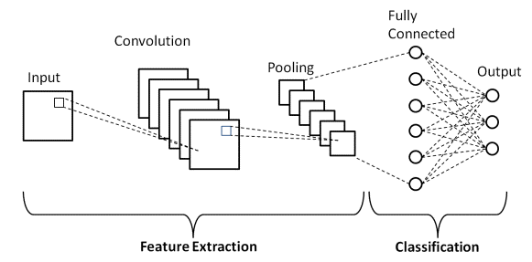
Layers in CNN
It has various layers like:
Convolutional Layer:- CNNs use filters or Kernels, each capturing different features of the input. These filters are learned during the training phase of the network, where the weights are adjusted to minimize the difference between the predicted output and the actual output.
Pooling Layer: Pooling layers reduce the spatial dimensions of the feature maps
Dense Layer: These layers are responsible for making predictions based on the extracted features.
Flatten Layer: Flattening is used to convert all the resultant 2-Dimensional arrays from pooled feature maps into a single long continuous linear vector.

Slide 5
Methodology
Dataset
The data consist of 48 X 48-pixel images of faces. The faces have been categorized into facial expression in to one of seven category
The training set consist of 28,709 images while the test set consist of 3,589.
Data Preprocessing
Normalization: Since computational complexity is high for computing pixel values in the range of (0-255), the data in pixel field is normalized to values between [0-1].
The respective emotion labels and their respective pixel values are stored in objects.
We use scikit-learn's train_test_split() function to split the dataset into training and testing data. The test_size being 0.1 meaning, 10% of data is for validation while 90% of the data will be trained.

Slide 6

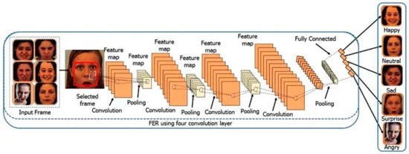



Process

Slide 7

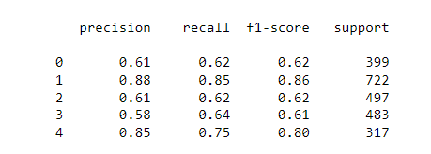
Result and Discussion
The model give us 76% of training accuracy and 70.6% for testing
The accuracy is low because of many variations in the dataset and due to its large size.
Despite of low accuracy the model is working well in real-time.

Slide 8
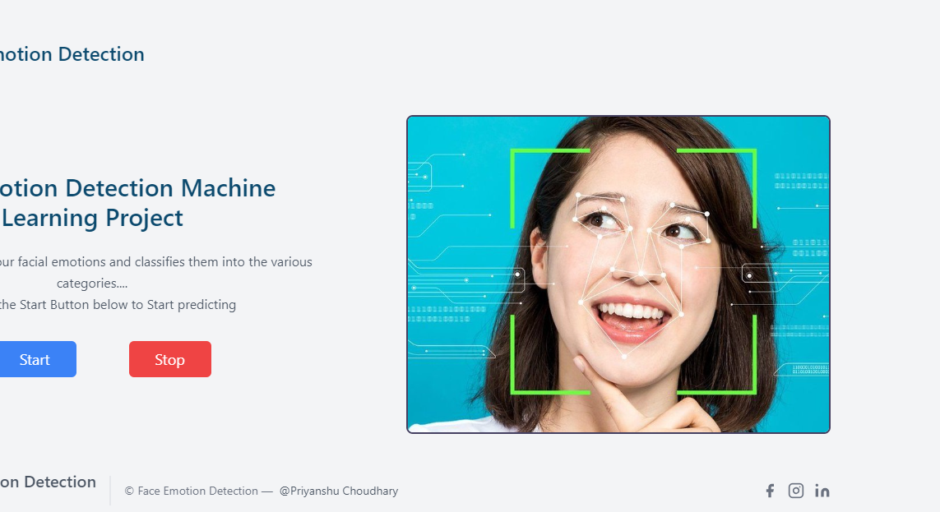

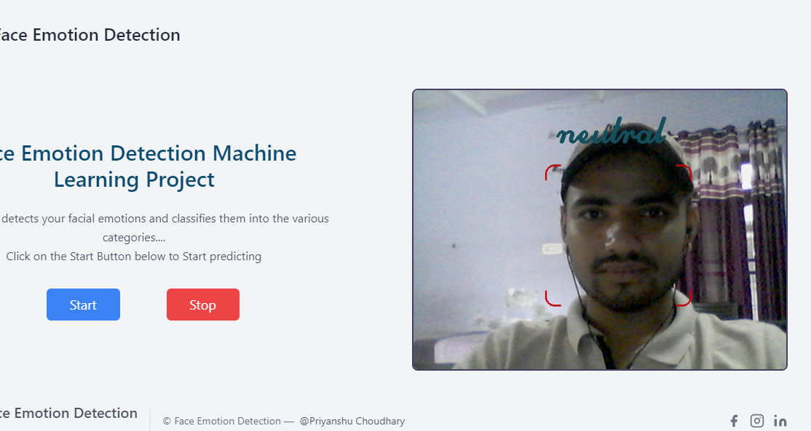


Slide 9
Conclusion and future work
Conclusion
I used CNN for face emotion detection, and it give accuracy of about 71%.
This technique is used to classify the human emotions in 5 categories angry, happy, neutral, sad, surprise.
Future Work
This project can be extended to the more classes as our model now works only for 5 classes.
We can try to play with the model to find out different models and check if we get more accuracy.

Slide 10


